Slide 1
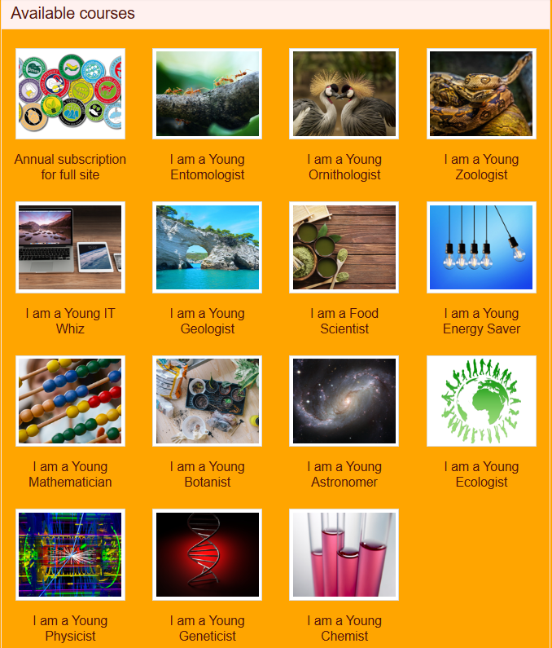
I am a Young Scientist
Platform access instructions for students
https://youngscientist.sscglobal.com.sg

Slide 2
If you have already gotten an account

Slide 3
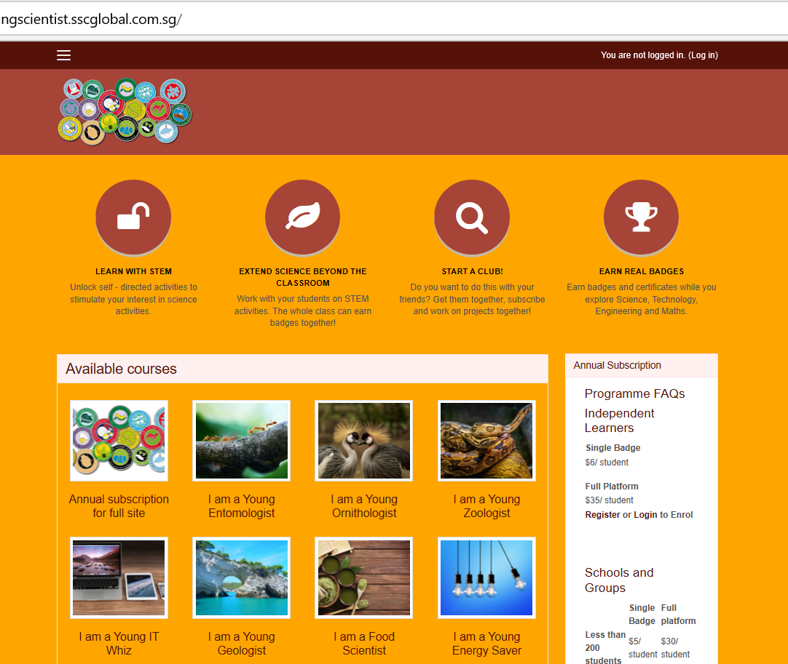
Click the login button in the top right-hand corner

Slide 4
Enter your user name and password

Slide 5
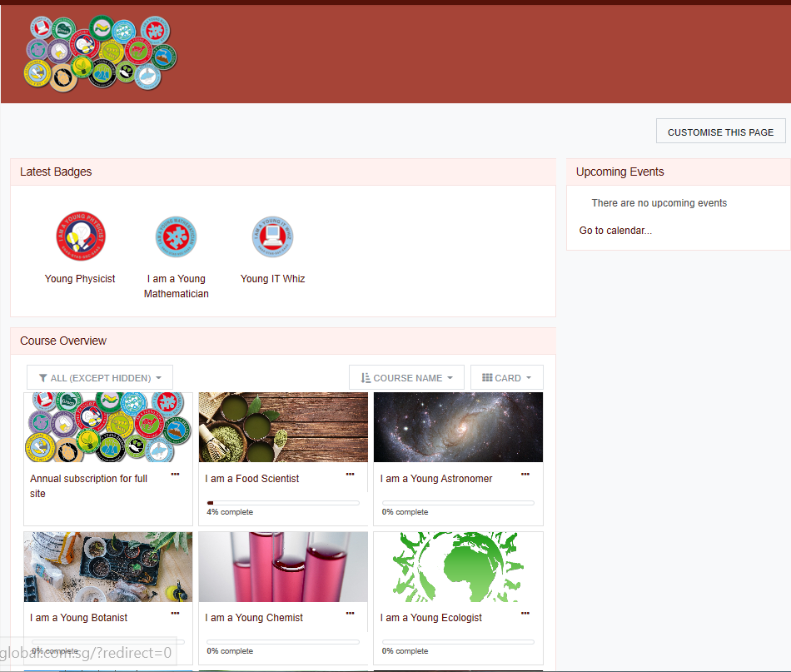
When you log in
You can see your badges under latest badges
You can see the courses you are subscribed to under Course overview

Slide 6
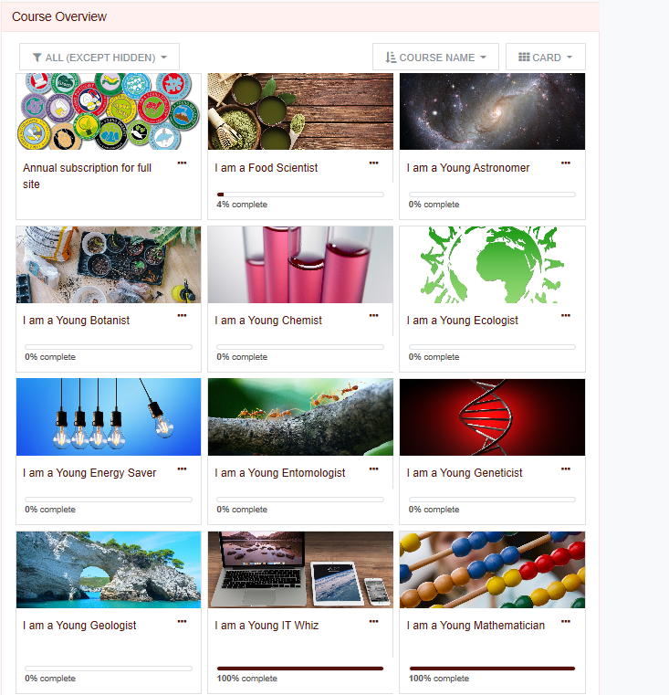
Course completion is indicated in a status bar under the name of the programme

Slide 7
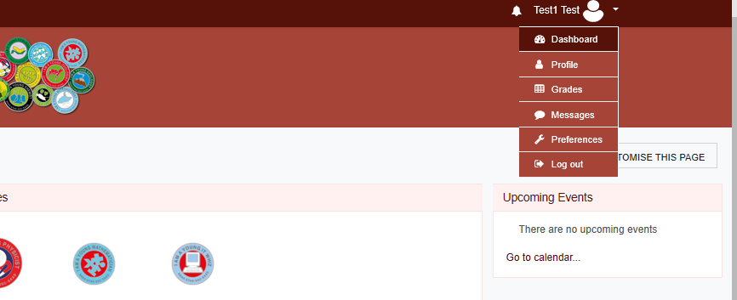
Click your name on the top right hand corner and click grades to see your grades

Slide 8
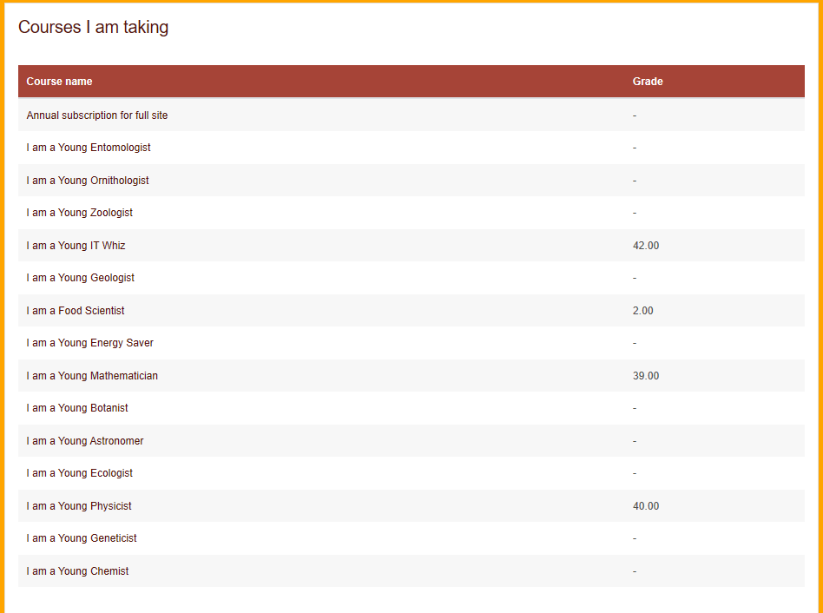
You can see the grades under the name of the class
You will receive a badge if you get a grade 15 or higher

Slide 9
How to submit an assignment
https://youtu.be/QwI8cPGVUNI

Slide 10
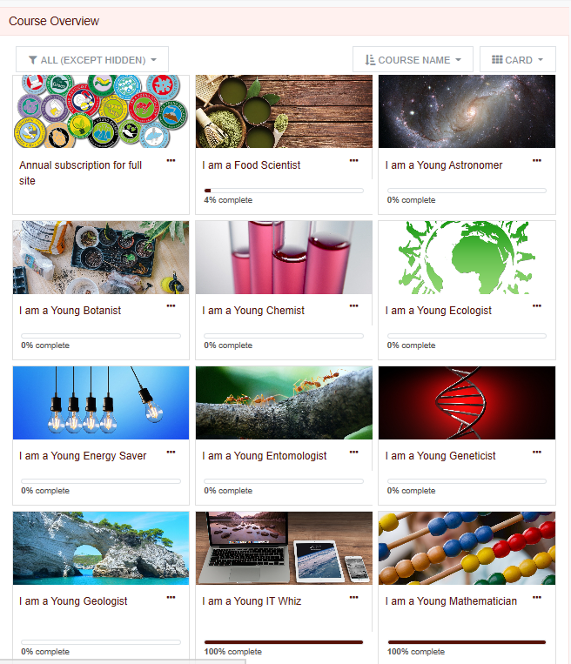
Select the course

Slide 11
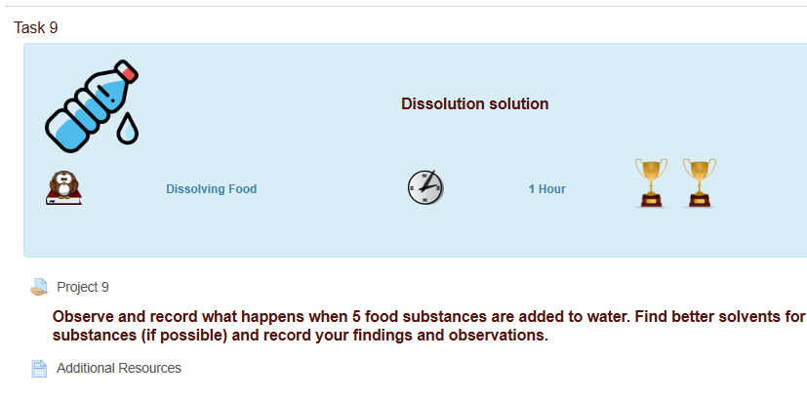
Scroll down to choose the task
Click the icon with a hand (e.g. Project 9) to open the submission

Slide 12
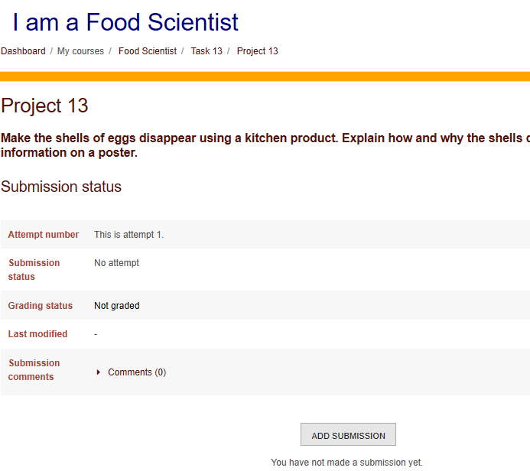
Click Add Submission

Slide 13
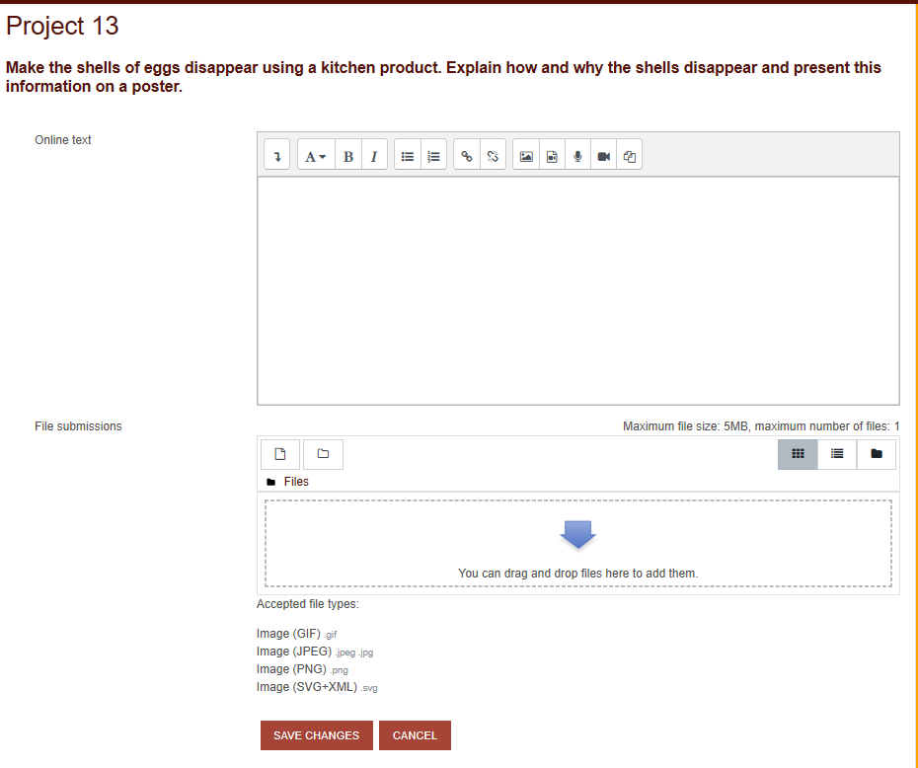
Write your project details
You can write online text in the top area
You can write/ draw on a piece of paper, poster and take a photo to upload in the area below
Maximum upload size is 5Mb

Slide 14
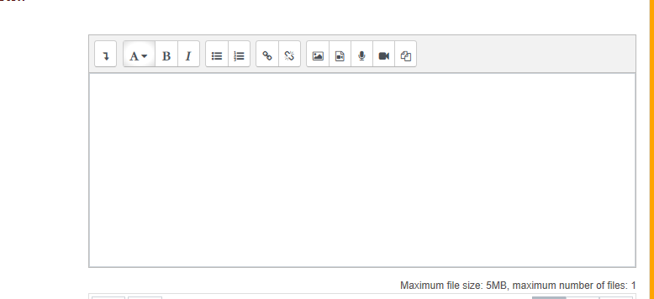
In your submission, use the icons to add
Hyperlinks
Images
Videos
Voice recordings
Maximum file size is 5Mb

Slide 15
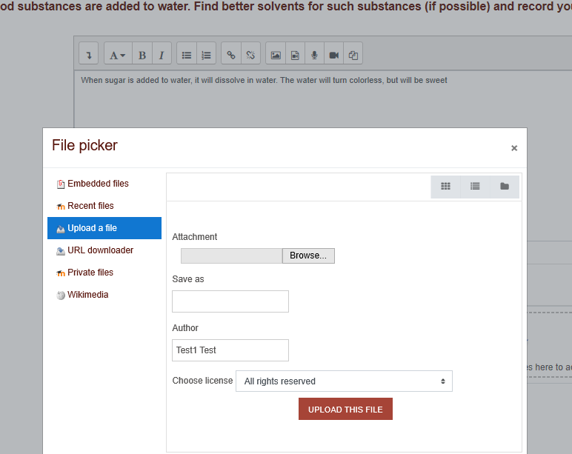
To add photos
Click the image icon, then click upload a file
Use browse to find the file in your device

Slide 16
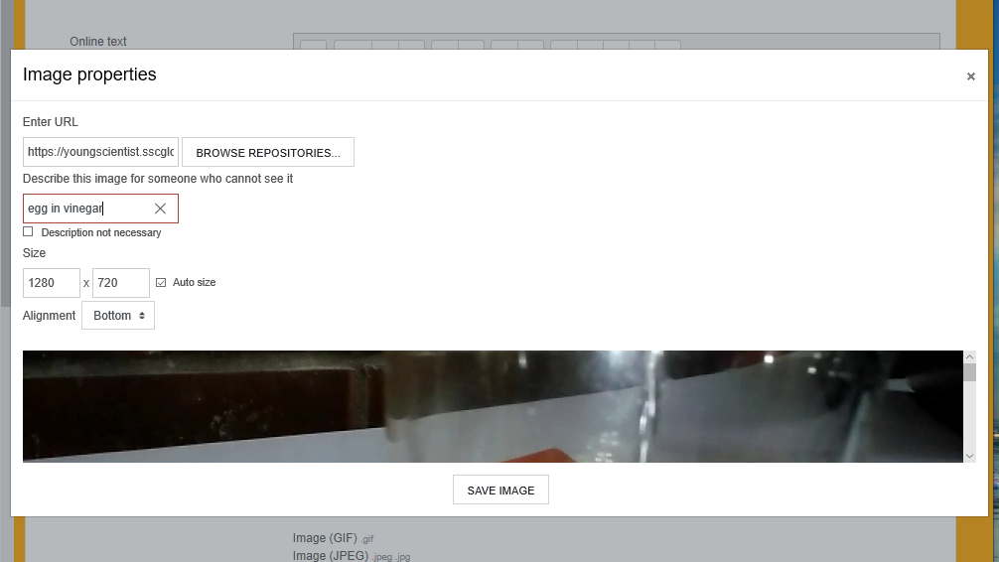
Write the description of the photo
Change the size of he photo if needed
Click save image

Slide 17
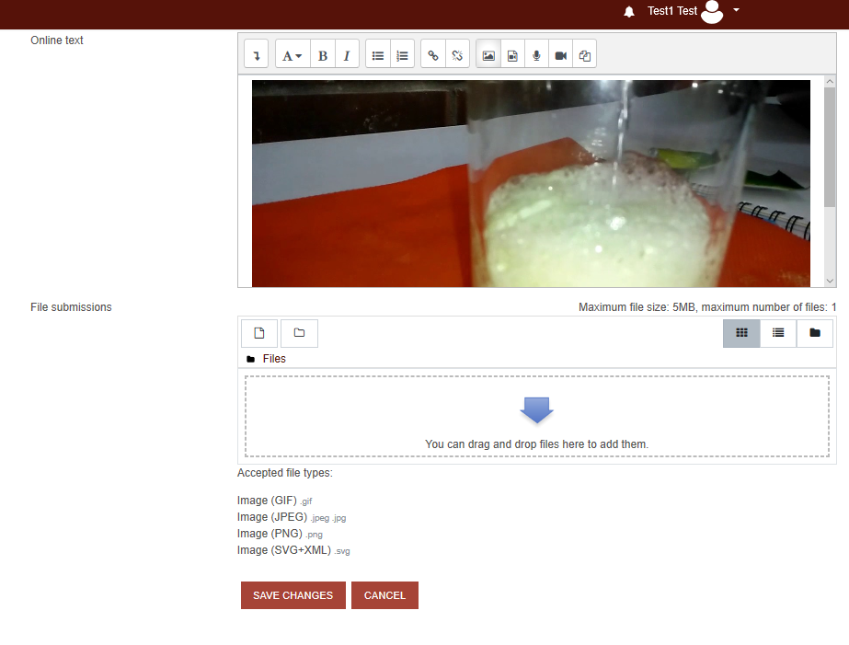
When you are happy with your submission, click save changes

Slide 18
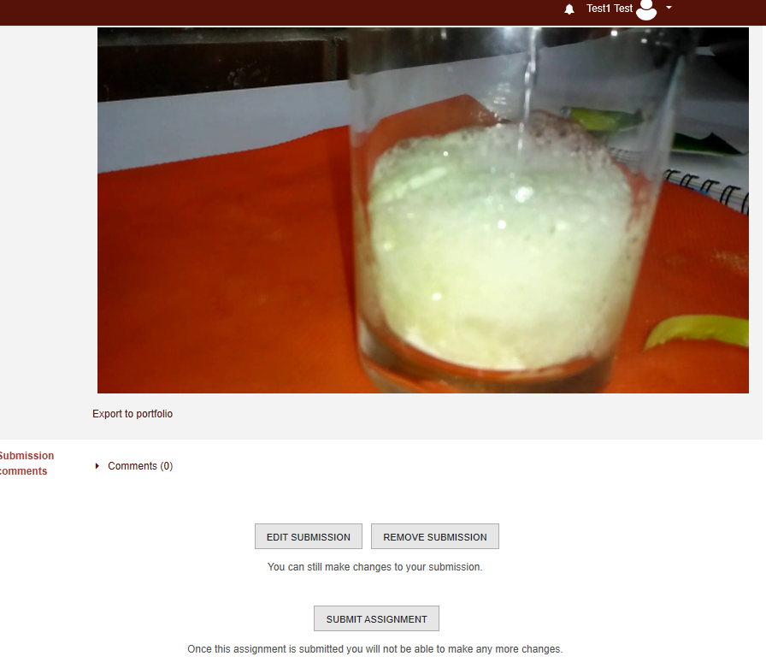
Review your submission
Click submit assignment if you are happy with your submission
You can click edit submission if you want to change it

Slide 19
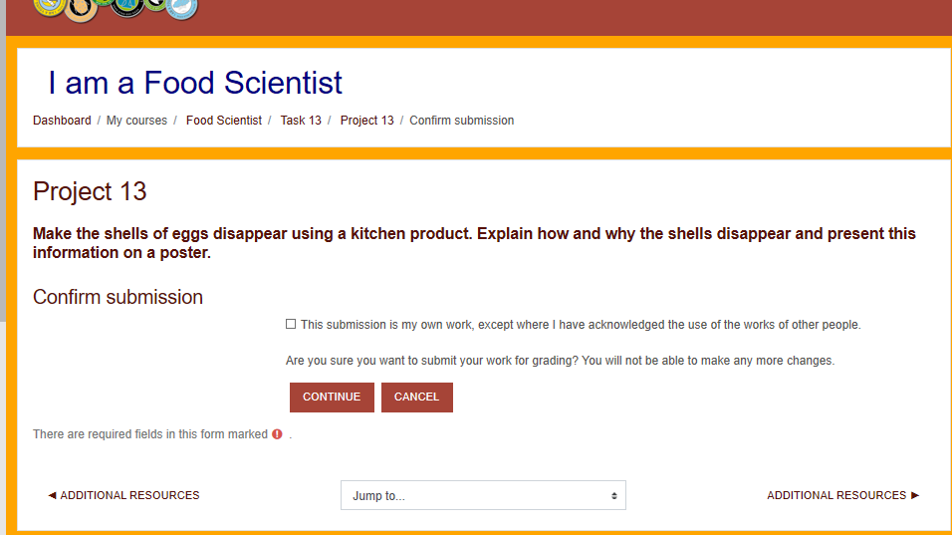
Validate that the submission is your own work
If you refer to websites in your work, you need to write the information in your own words.
The graders will reject your submission if it is copied from the internet

Slide 20
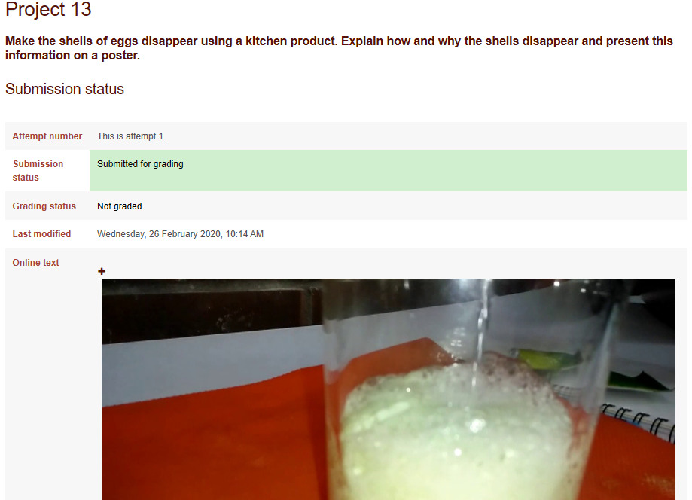
After you click the submit button, the submission status will be “Submitted for grading”
You can continue to do other activities while waiting for a grader to grade your work

Slide 21
After the project has been graded

Slide 22
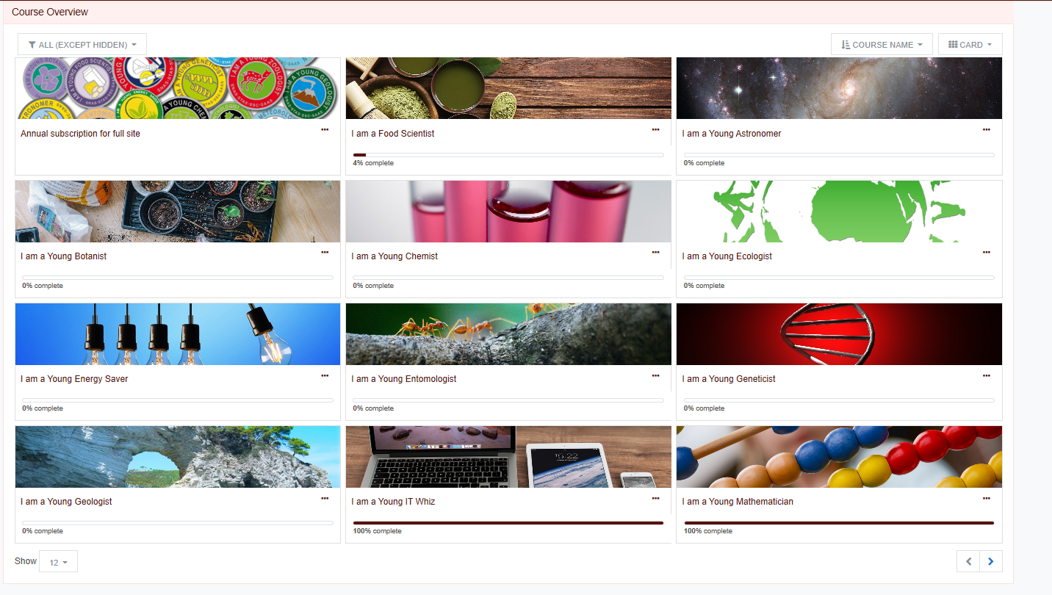
When a grader has graded your project
You will receive an email saying that your project is graded (if you have an email address)
When you log in, the progress bar will be updated

Slide 23
Badges
E- Badges will be automatically awarded when you receive 15 points for the course
A representative from Science Centre will contact you with details on the Young Scientist award ceremony and how you can receive the physical badges and certificate.
Notes:
No faces and PDPA policy

Slide 24
Download Certificate (NOTE: not all courses issue a certificate when completed)

Slide 25
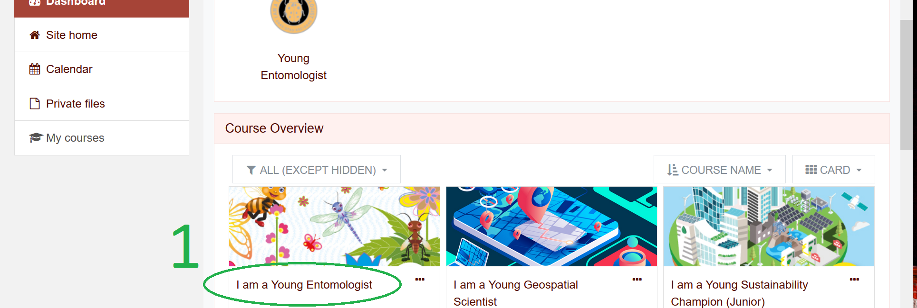
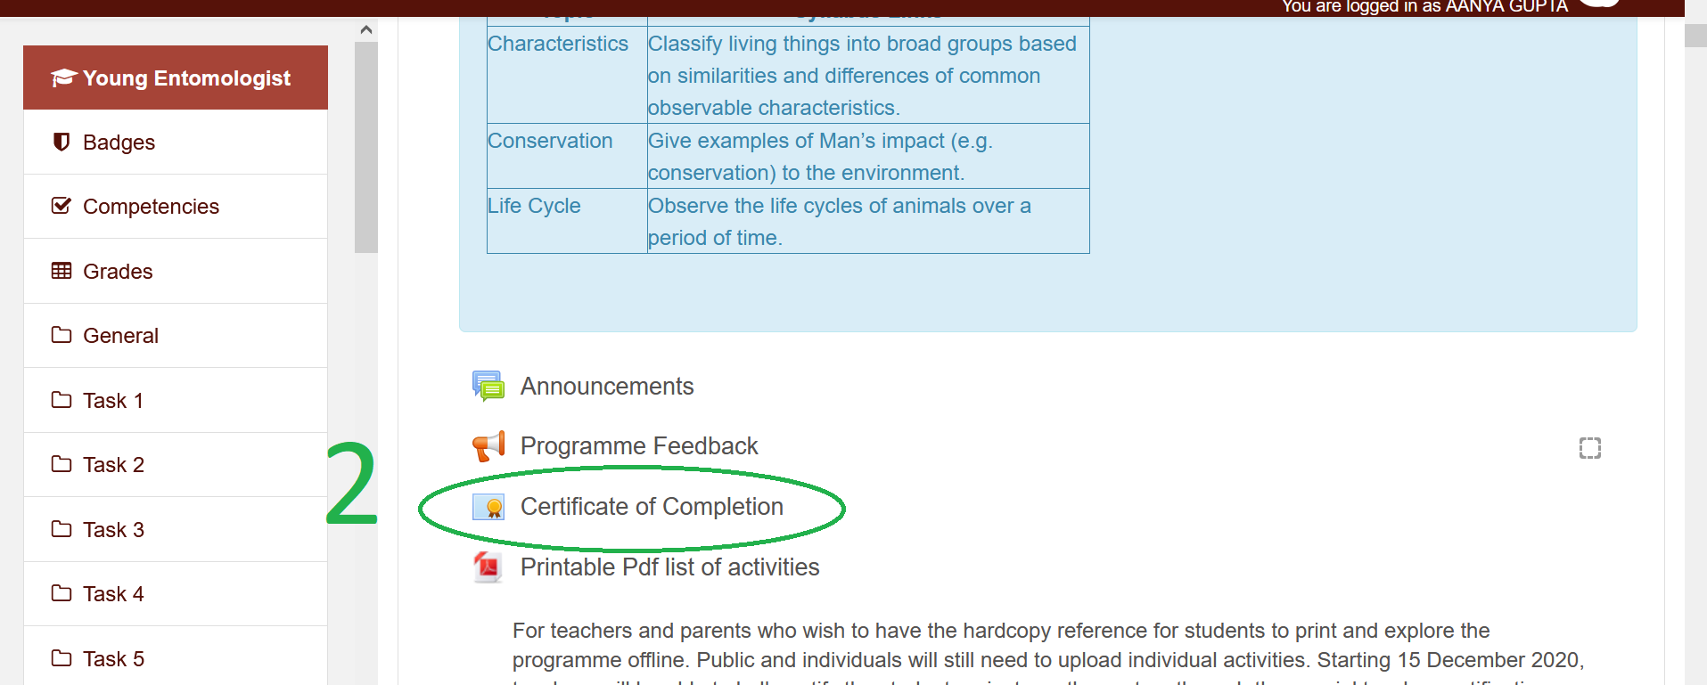
If your course issues a certificate upon completion
You will be able to View / Download the certificate
After log-in, click on the Course
Scroll down and find the ‘Certificate of Completion’ link below the course’s banner image, then click it

Slide 26
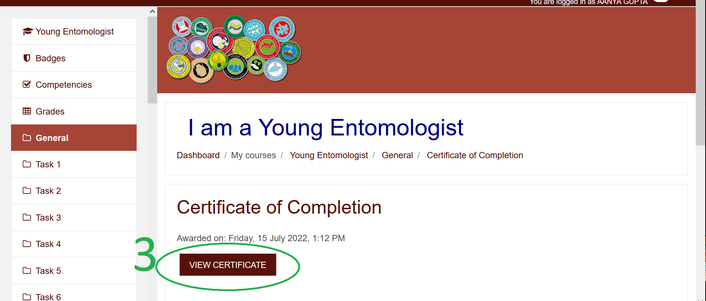
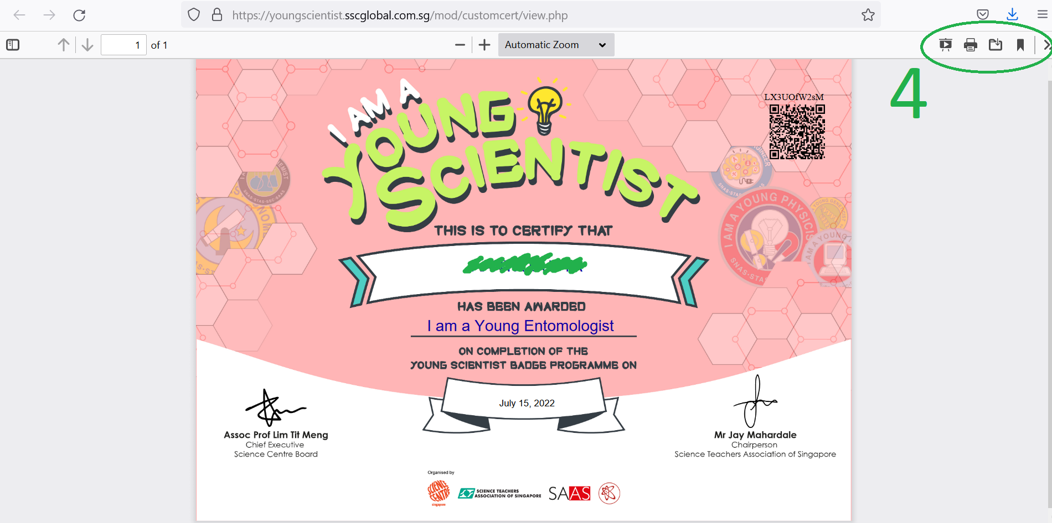
If your course issues a certificate upon completion
Click ‘View Certificate’
Your certificate will open as a PDF file in your web browser, you can download or print the PDF file as needed.
(buttons to download/print shown differently according to your web browser)

Slide 27
Happy learning!

